Slide 1
Staj Sunum

Slide 2
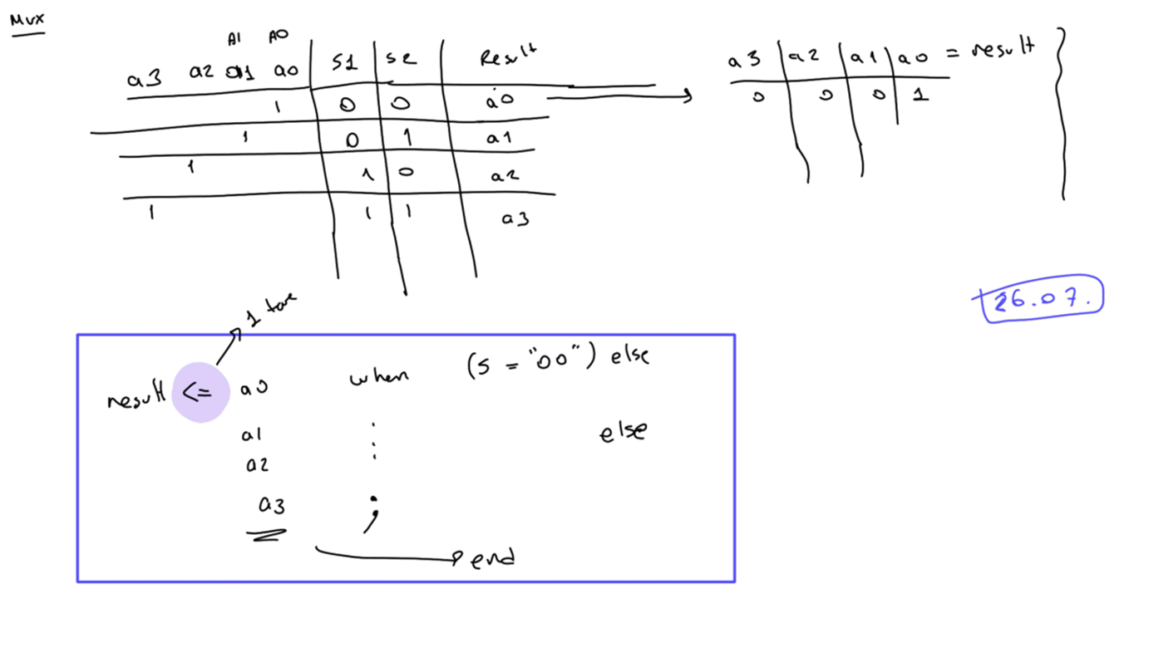
4x1 MUX

Slide 3
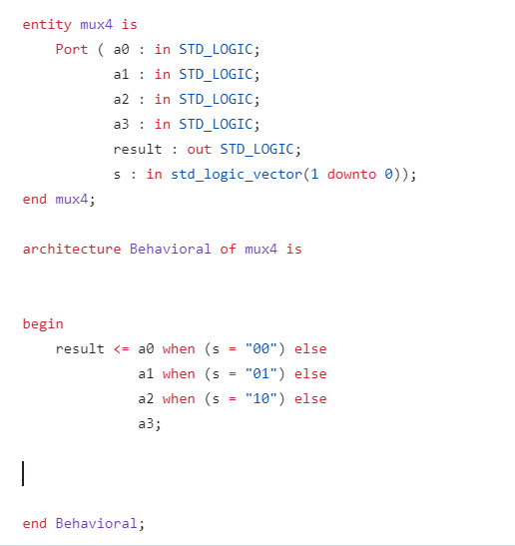
4x1 MUX

Slide 4
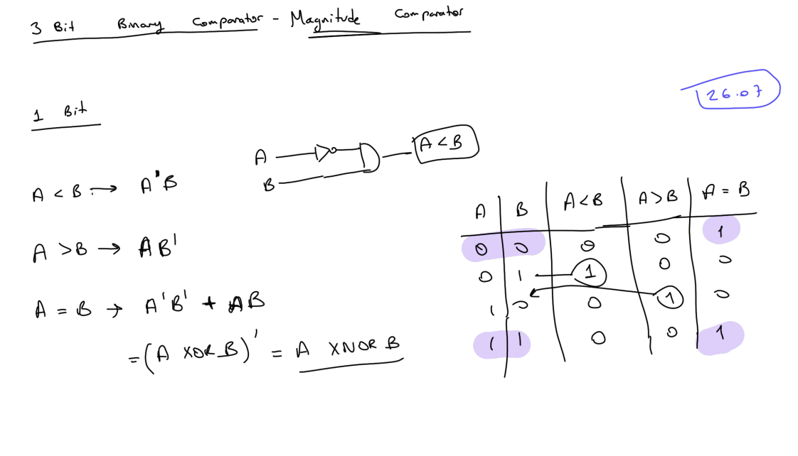
3 Bit Binary Comparator

Slide 5
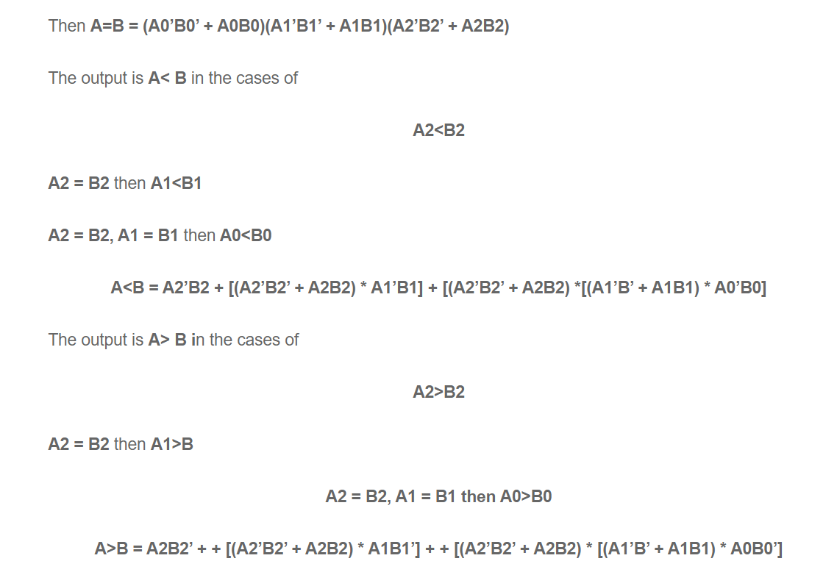
3 Bit Binary Comparator

Slide 6
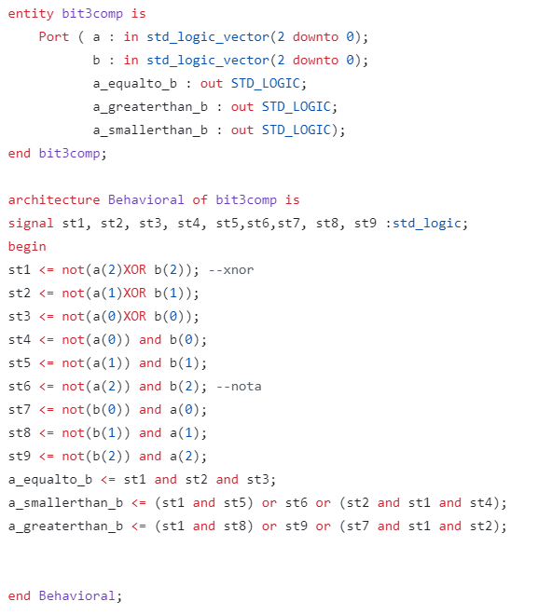
3 Bit Binary Comparator
library IEEE;
use IEEE.STD_LOGIC_1164.ALL;
use IEEE.NUMERIC_STD.ALL;
entity comparator_3bit is
Port (
a : in STD_LOGIC_VECTOR(2 downto 0);
b : in STD_LOGIC_VECTOR(2 downto 0);
a_gt_b : out STD_LOGIC;
a_lt_b : out STD_LOGIC;
a_eq_b : out STD_LOGIC
);
end comparator_3bit;
architecture Behavioral of comparator_3bit is
begin
process(a, b)
begin
if a > b then
a_gt_b <= '1';
a_lt_b <= '0';
a_eq_b <= '0';
elsif a < b then
a_gt_b <= '0';
a_lt_b <= '1';
a_eq_b <= '0';
else
a_gt_b <= '0';
a_lt_b <= '0';
a_eq_b <= '1';
end if;
end process;
end Behavioral;

Slide 7
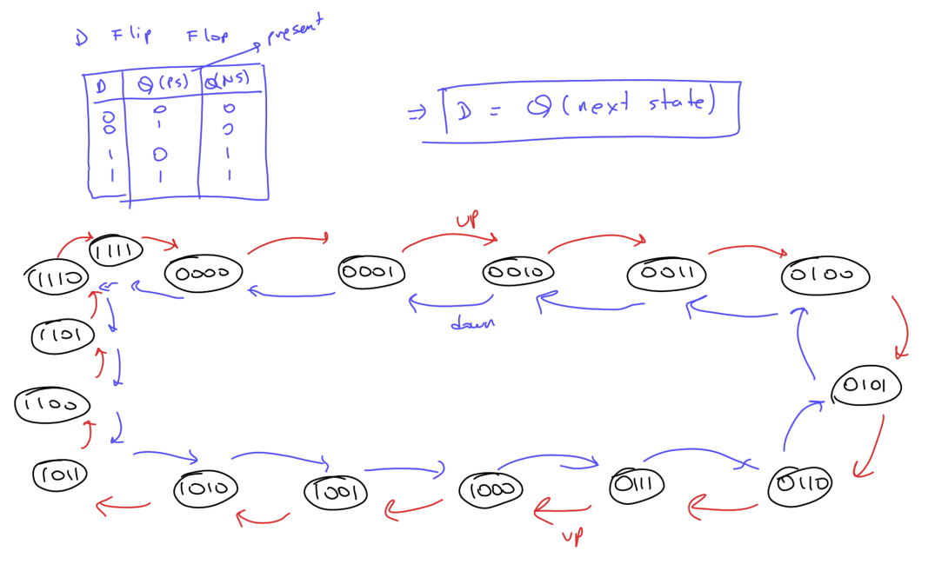
Up-Down Counter Logic

Slide 8
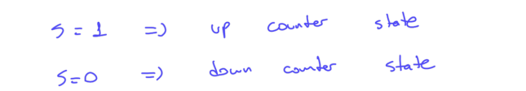
Bidirectional (up-down) 4 bit counter
library IEEE;
use IEEE.STD_LOGIC_1164.ALL;
use IEEE.STD_LOGIC_ARITH.ALL;
use IEEE.STD_LOGIC_UNSIGNED.ALL;
entity UpDownCounter is
Port (
clk : in std_logic;
reset : in std_logic;
up_down : in std_logic; -- Control signal: '1' for up, '0' for down
count : out std_logic_vector(3 downto 0) -- 4-bit counter
);
end UpDownCounter;
architecture Behavioral of UpDownCounter is
signal counter : std_logic_vector(3 downto 0);
begin
process(clk, reset)
begin
if reset = '1' then
counter <= (others => '0');
elsif rising_edge(clk) then
if up_down = '1' then
counter <= counter + 1;
else
counter <= counter - 1;
end if;
end if;
end process;
count <= counter;
end Behavioral;

Slide 9
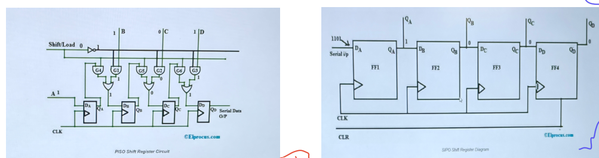
Shift Registers

Slide 10
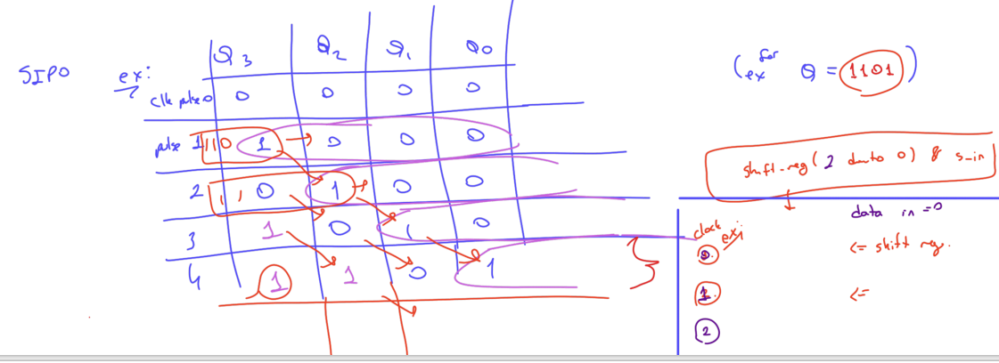
Serial in parallel out shift register
library IEEE;
use IEEE.STD_LOGIC_1164.ALL;
use IEEE.STD_LOGIC_ARITH.ALL;
use IEEE.STD_LOGIC_UNSIGNED.ALL;
entity SIPO_ShiftRegister is
Port (
clk : in std_logic;
reset : in std_logic;
serial_in : in std_logic;
parallel_out : out std_logic_vector(7 downto 0)
);
end SIPO_ShiftRegister;
architecture Behavioral of SIPO_ShiftRegister is
signal shift_reg : std_logic_vector(7 downto 0);
begin
process(clk, reset)
begin
if reset = '1' then
shift_reg <= (others => '0');
elsif rising_edge(clk) then
shift_reg <= shift_reg(6 downto 0) & serial_in;
end if;
end process;
parallel_out <= shift_reg;
end Behavioral;

Slide 11
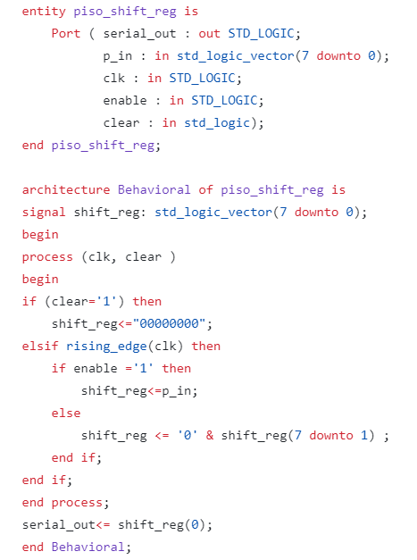
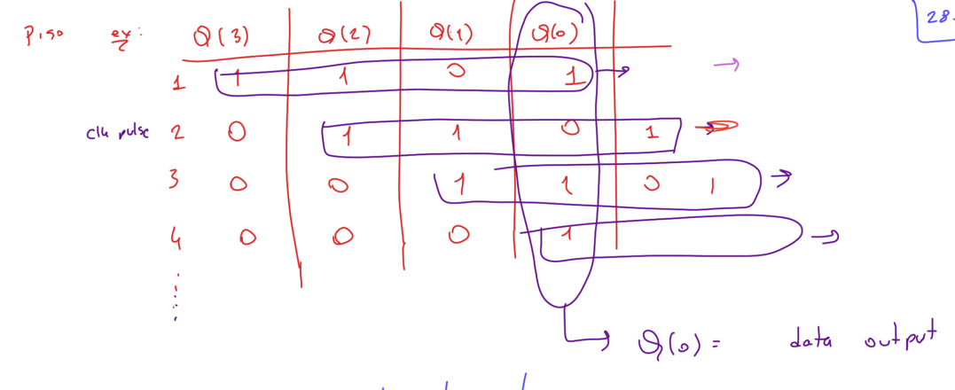
Parallel in serial out shift register

Slide 12
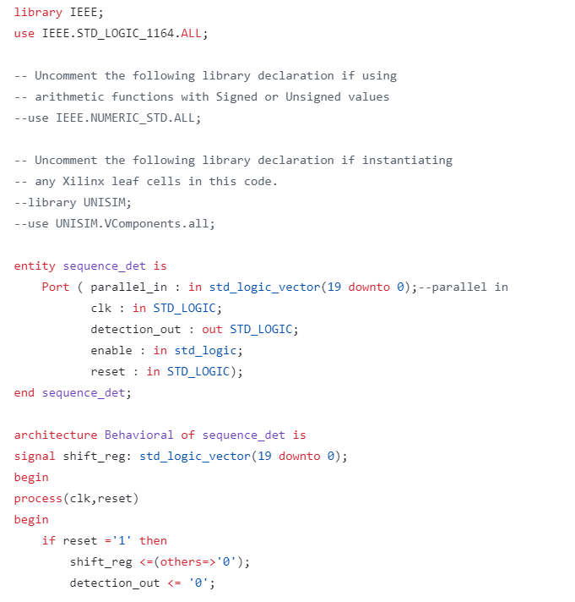
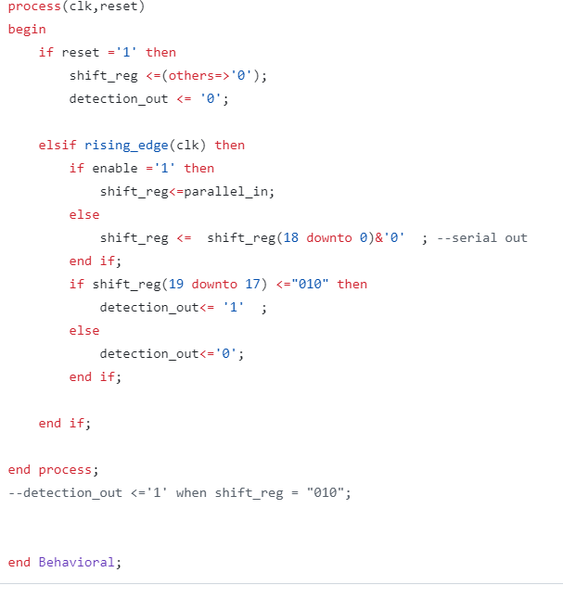
010 Overlapping Sequence detector in 20 bit data

Slide 13
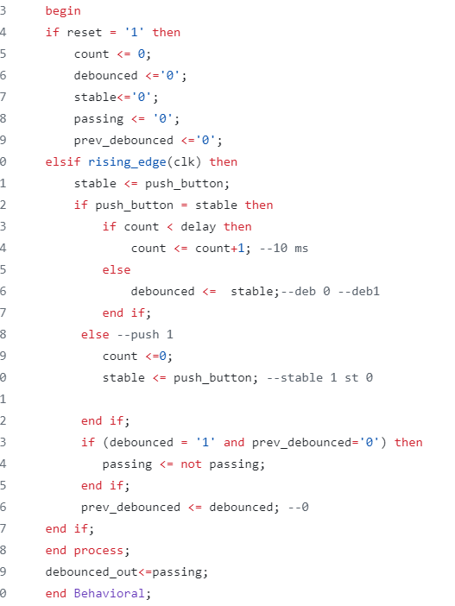
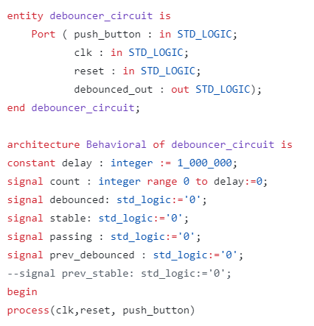
Debouncer Circuit
Push button’ın o anki durumu stable’a eşit ve push button 10 ms boyunca sabit(stable’a eşit) ise stabil sayılır ve debounced stable’a eşitlenir,debounced 0dan 1e geçerken debounced_out’un 1 kalması için passing kendi değiline eşitlenir.

Slide 14
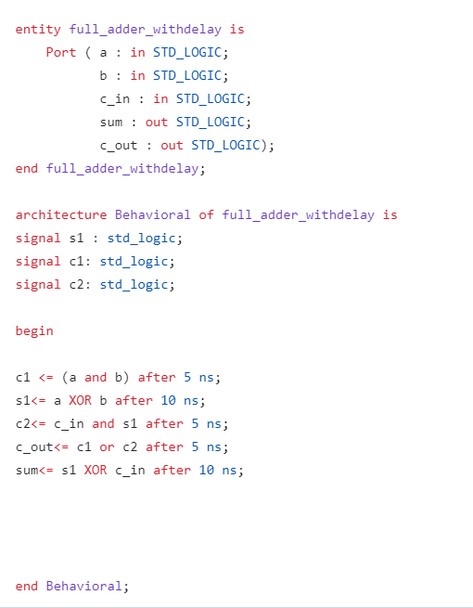
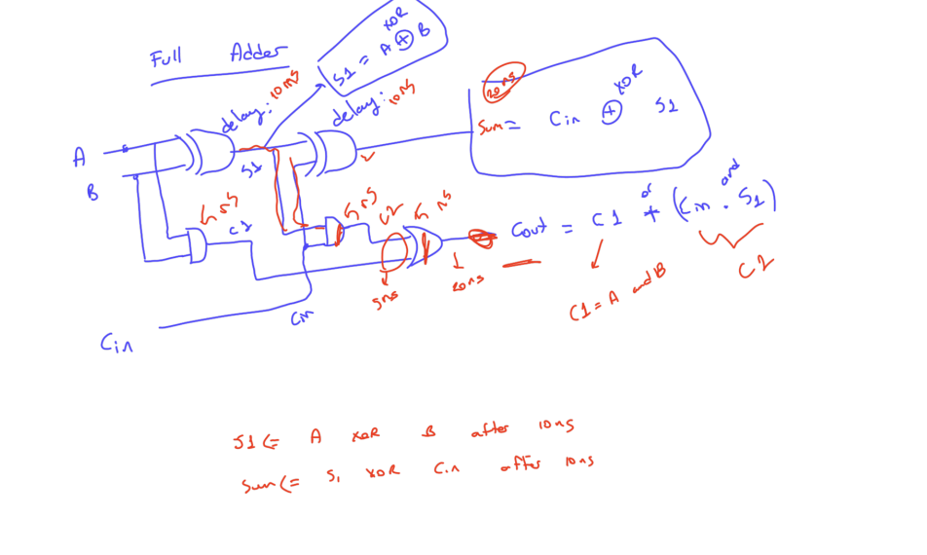
Full Adder

Slide 15
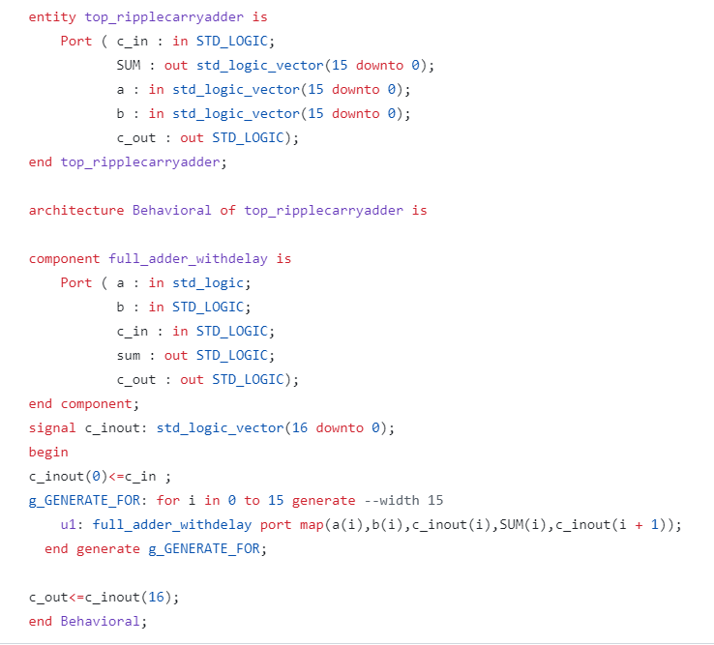
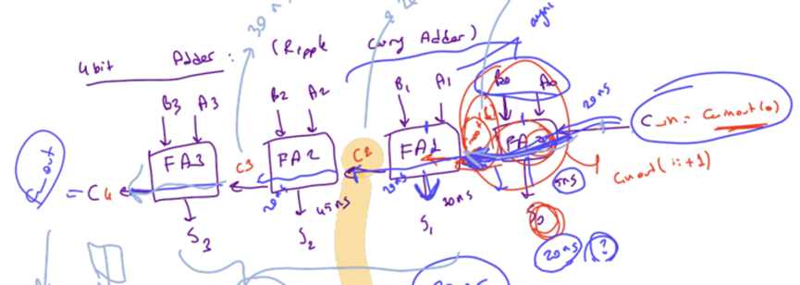
Ripple Carry Adder

Slide 16
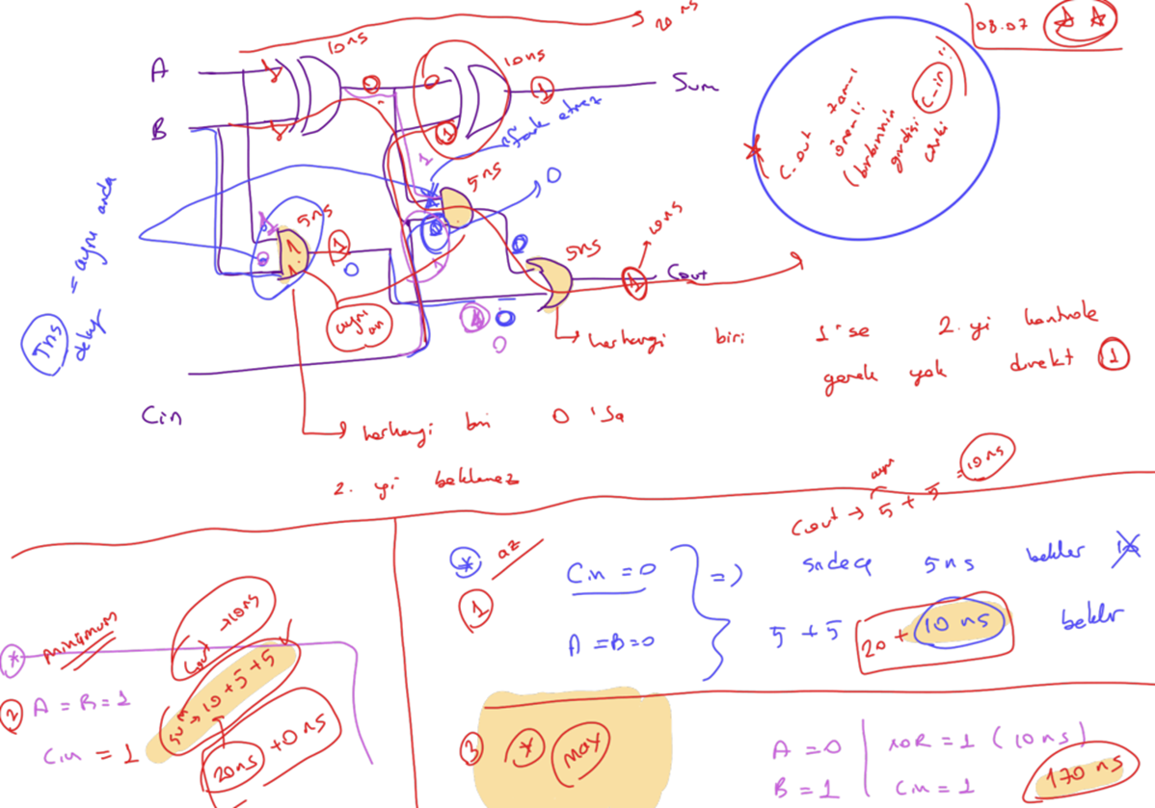
Ripple Carry Adder- different delay

Slide 17
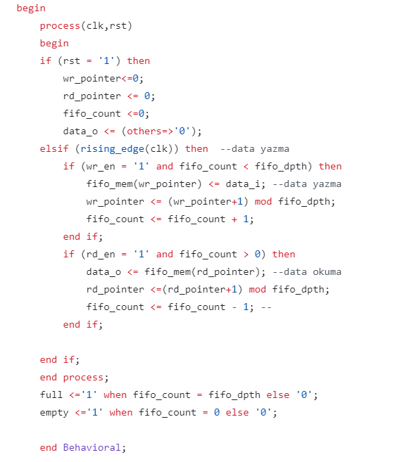
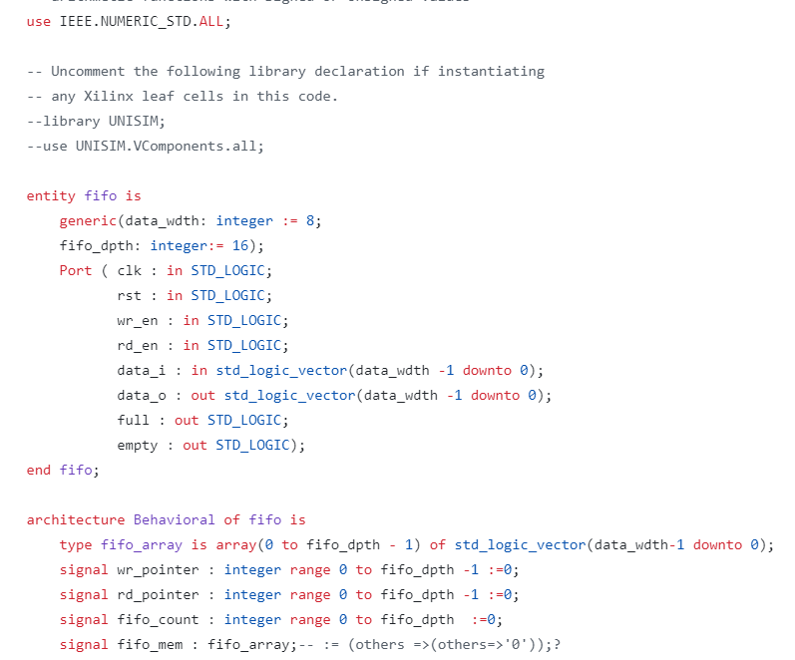
FIFO design

Slide 18
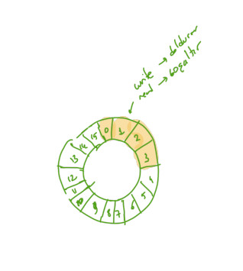
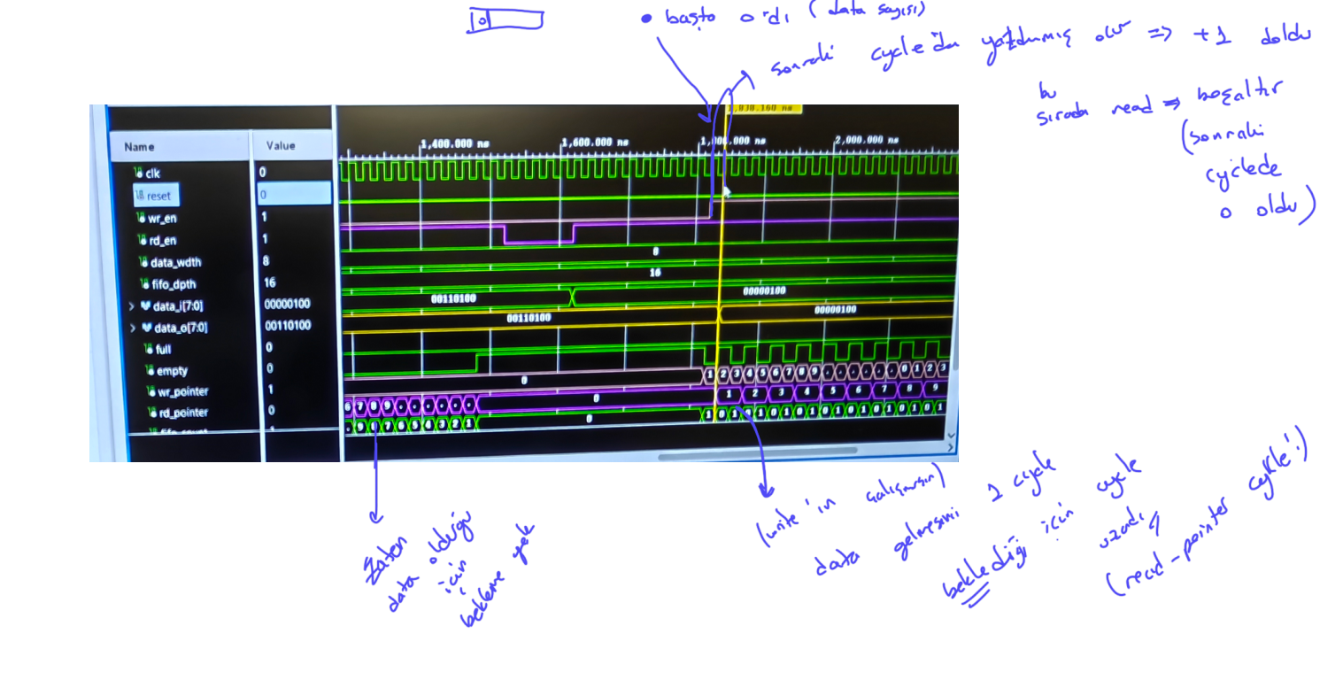
FIFO Structure and Simulation

Slide 19
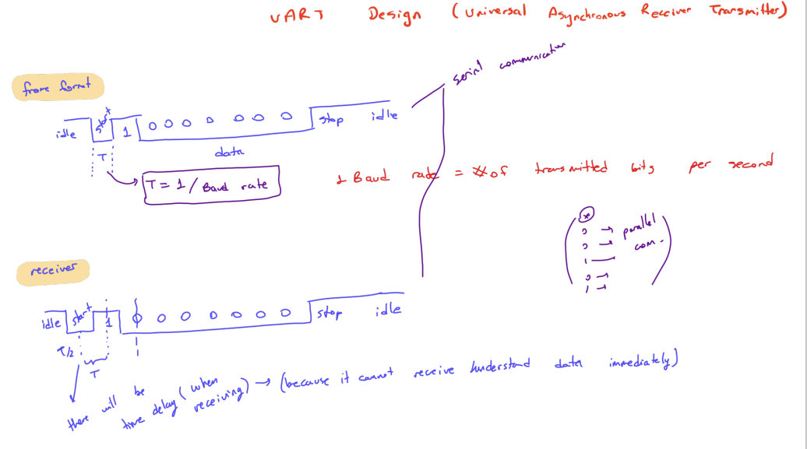
UART

Slide 20
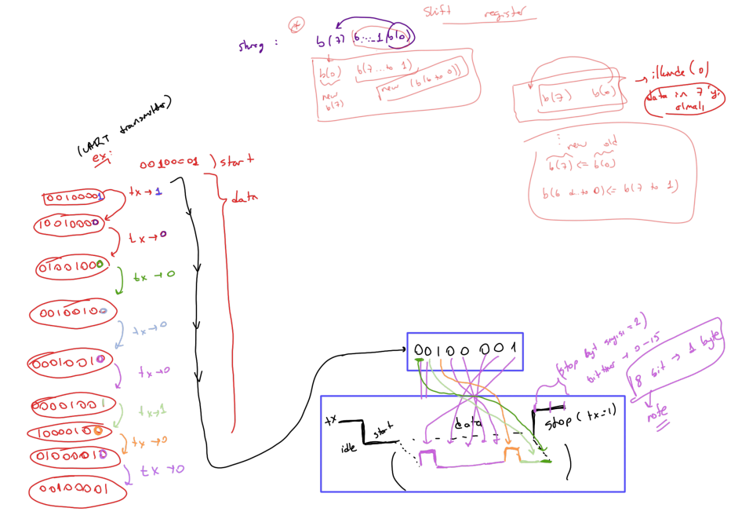
UART Transmitter TX

Slide 21
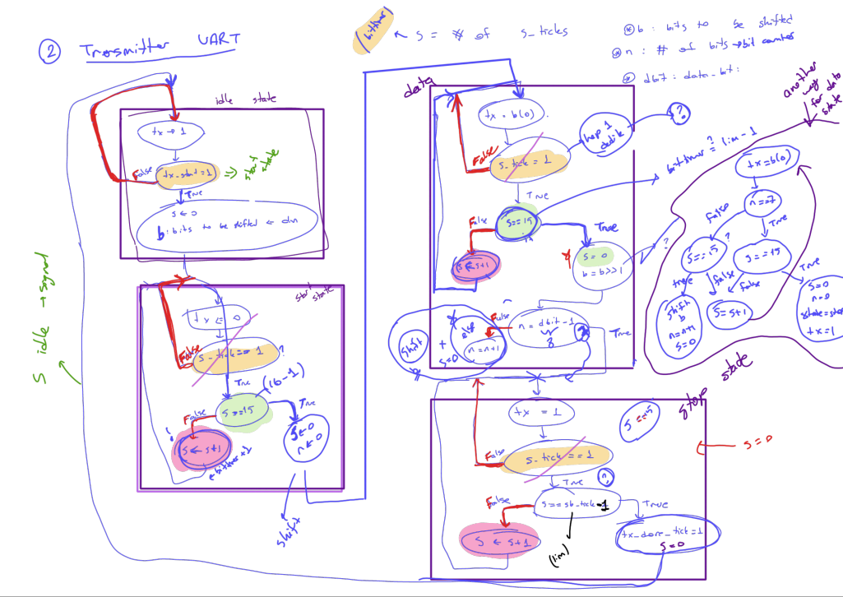
UART Transmitter TX

Slide 22
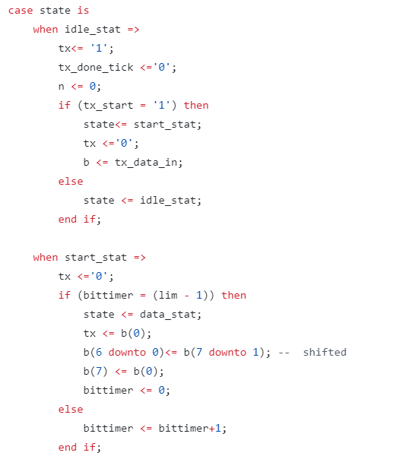
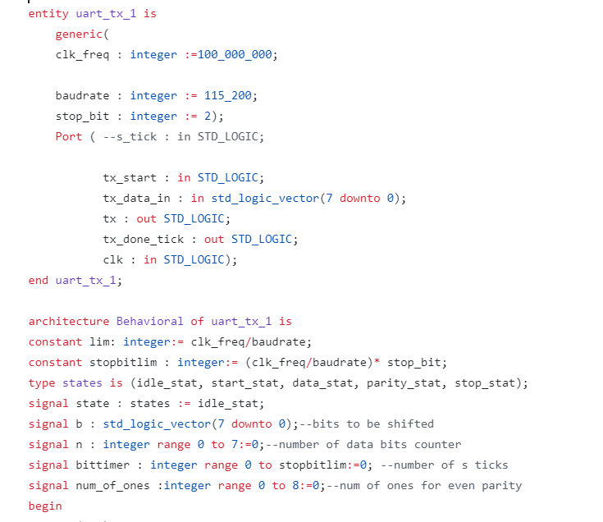
UART TX code

Slide 23
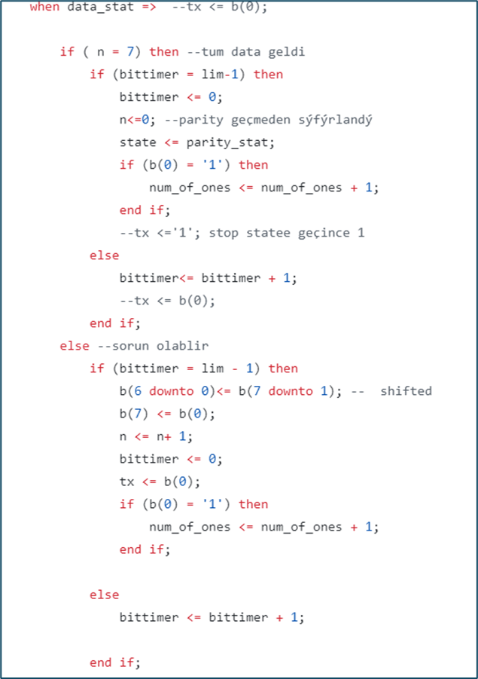
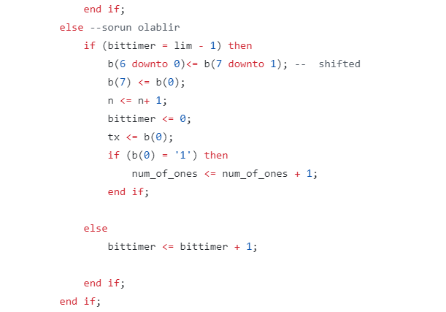
UART TX

Slide 24
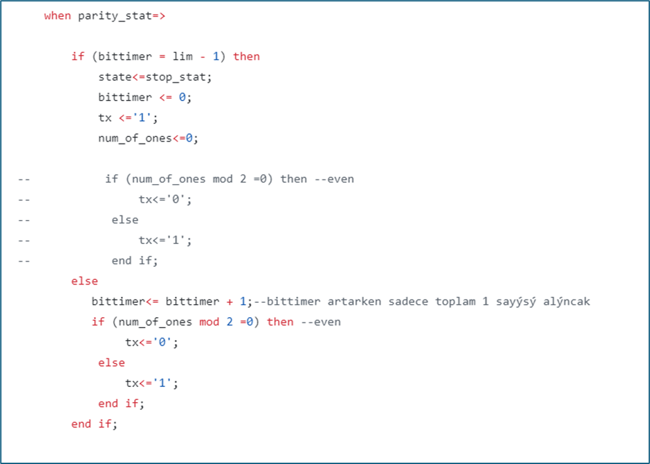
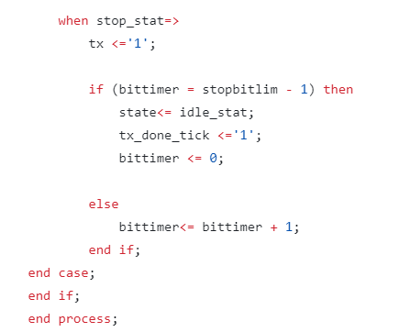
UART TX

Slide 25
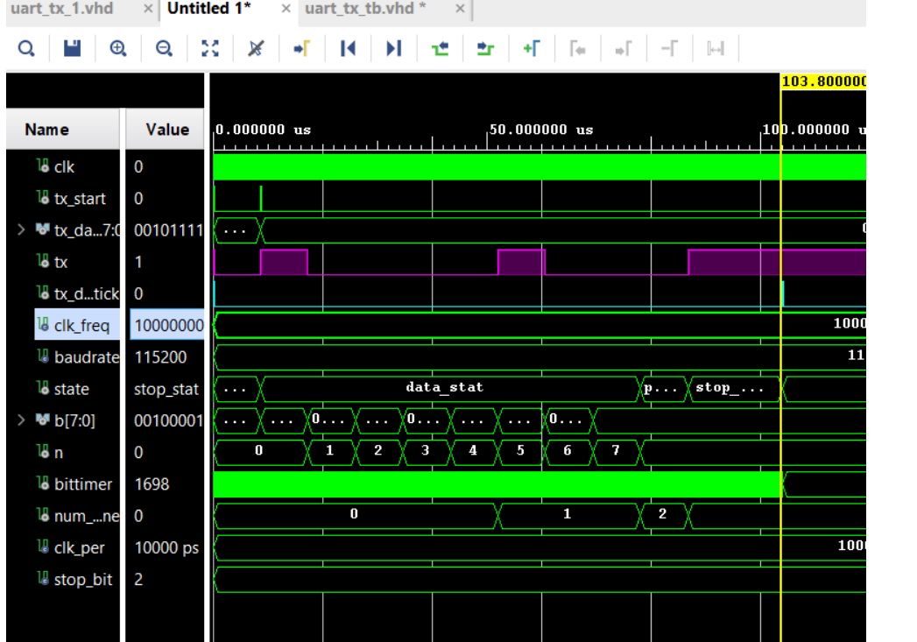
UART TX Simulation

Slide 26
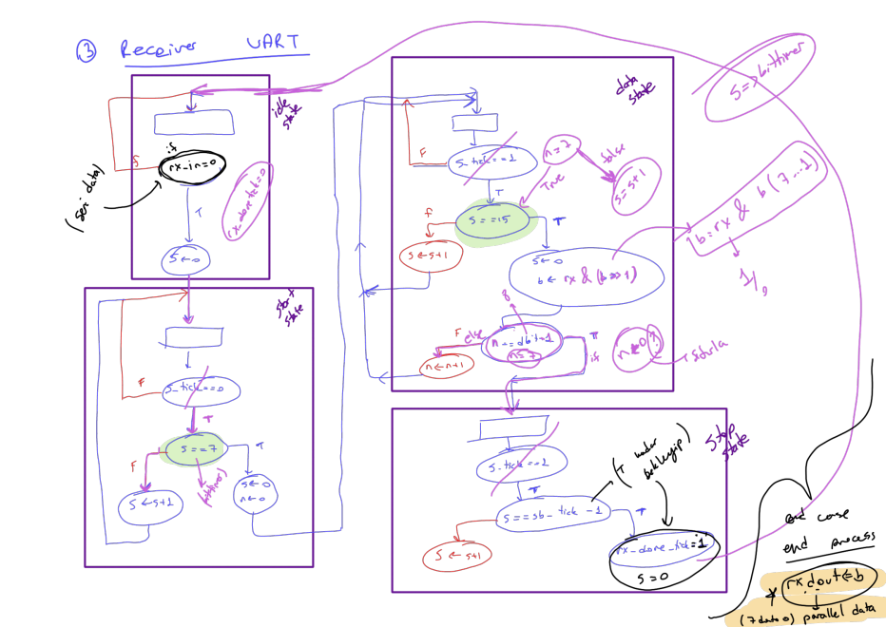
UART Receiver RX

Slide 27
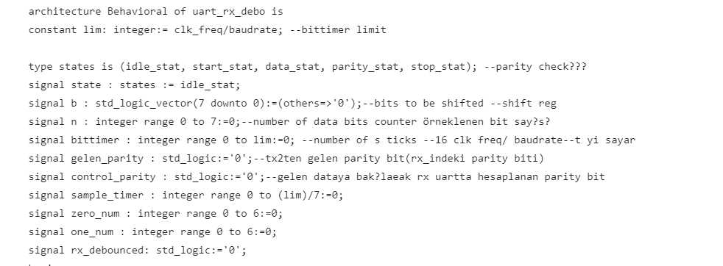
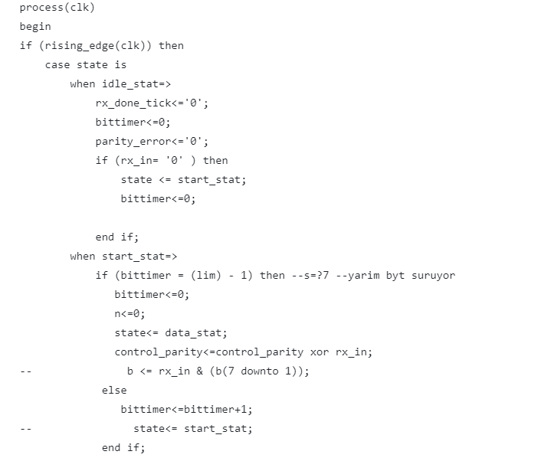
UART RX

Slide 28
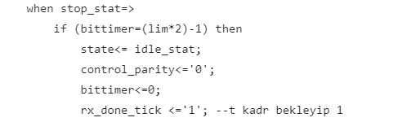
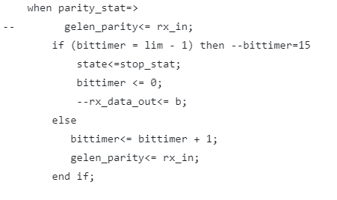
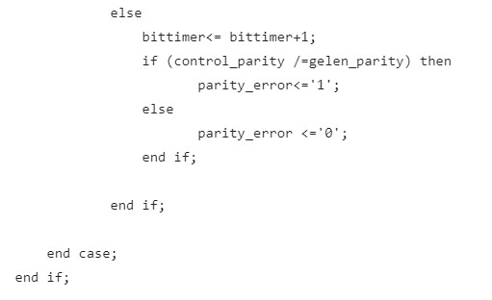
UART RX parity

Slide 29
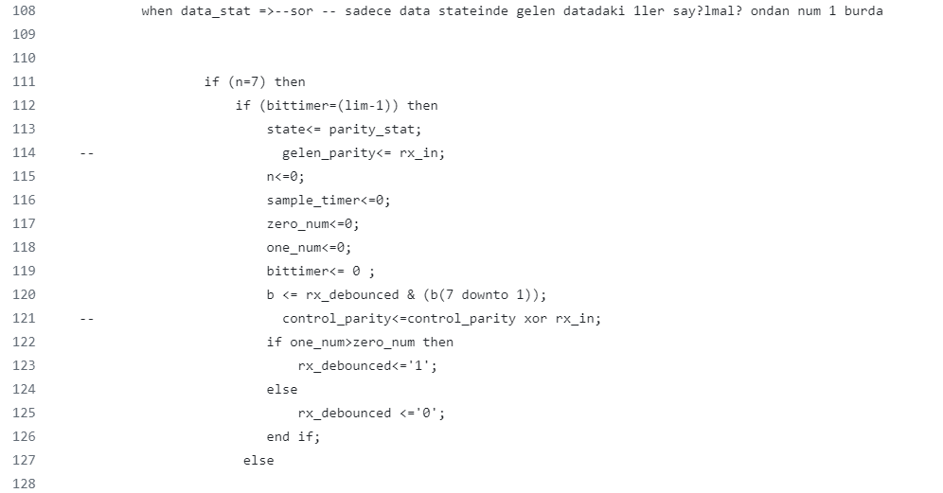
UART RX gürültü önleme

Slide 30
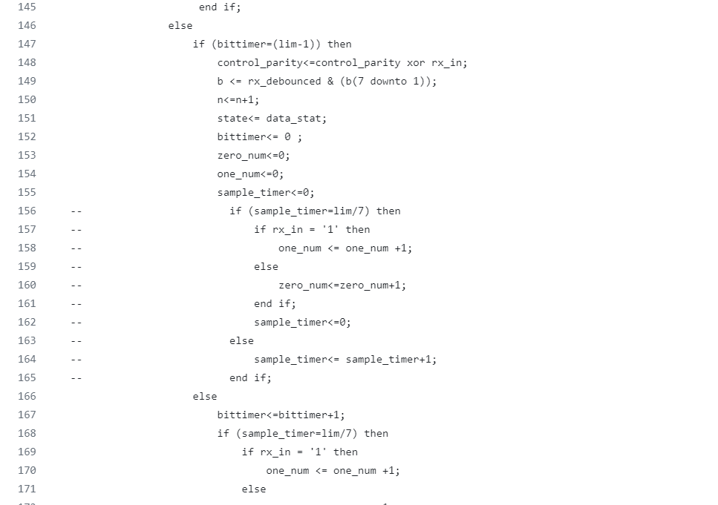
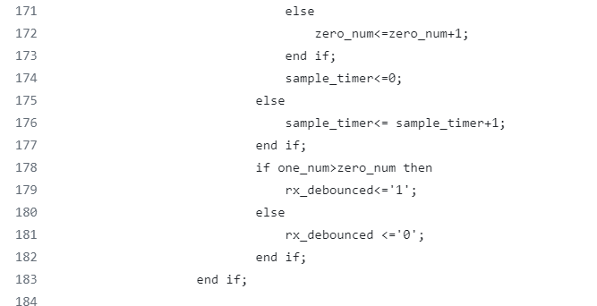
UART RX gürültü önleme

Slide 31
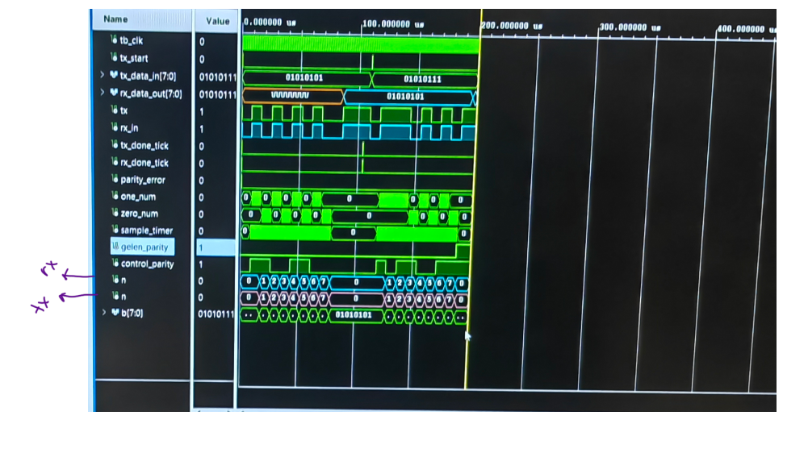
UART RX simulation

